Slide 1
CLASS - TREMATODA
Dr. R. Bindhusaran, Associate professor
DEPT OF PATHOLOGY, SKHMC, Kulasekharam

Slide 2
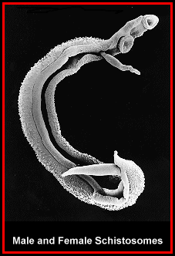
Trematodes
Posses two suckers which appear like holes( trematos – pierced with holes)
Leaf shaped and unsegmented, flat worms called flukes.

Slide 3
Classsification
Intestinal :
Hepatic
Lung trematodes
Blood dwelling

Slide 4
Terms Used in the Description of Trematodes
Distomata (from G. di, two; stoma, mouth). Possessing two suckers.
Acetabulum (from L., a shallow vinegar vessel or cup). A muscular organ of attachment, commonly called “sucker”.
Miracidium (from G “a little boy”). The first larval stage coming out of the T rematode egg in water; infective to mollusk only.
Sporocyst (from G. sporos, seed; kystis, cell or bladder). The second larval stage of the Trematode occurring in the mollusc. Asexual multiplication occurs at this stage only in Schistosomes.
Redia (named after Francesco Redi, Italian naturalist). The third larval stage of the Trematode occurring in the mollusc. Asexual multiplication at this stage
Cercaria (G. kerkos, tail). The final stage of larval development of Trematodes in the mollusc, possessing a body and tail. It escapes into the surrounding water

Slide 5
SCHISTOSOMA HEMATOBIUM
Common Name: The vesical blood fluke
Geographical Distribution: Various parts of Africa and Middle East
Habitat. Adult worms live, in copula, in the pelvic venous plexus vesical, prostatic and uterine plexuses of veins

Slide 6
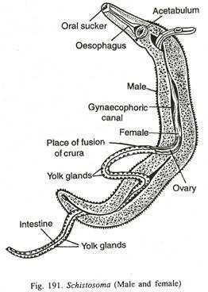

Slide 7
Morphology
In general, the three species of adult worms resemble each other closely; having a life span of 20 to 30 years.
Adult worm:
Flat and broad, male and females separate and male holds the female in the gynaecophoric canal, seen as couples
Posses two suckers

Slide 8
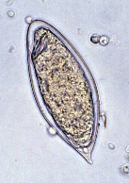
Eggs
Posses terminal spines

Slide 9
MECHANISM OF EGG-LAYING AND EGG-EXPULSION
Oviposition usually occurs in the small venules of vesical plexus.
The female, held in the gynaecophoric canal of the male, extends its anterior end far into the smallest venules and deposits the eggs longitudinally, one at a time. The eggs are held in position by the spines
eggs then work their way through the vessels and the mucosa of the urinary bladder, enter into the cavity and escape with the urine, usually at the end of the micturition.

Slide 10
Life Cycle.
S. haematobium passes its life cycle in two hosts.
Definitive Host. Man. Adult worm living in vesical and prostatic venous plexus.
Intermediate Host. Fresh-water snails (Bulinus truncatus )

Slide 11
LIFE CYCLE ( stage in water)
The embryonated eggs are passed with the urine of the definitive host and gain access to water.
Ciliated larvae (miracidia), hatched out of the eggs, move freely in water in search of their intermediate host.
The miracidium on entering its proper larval host, penetrates into the soft tissues of the snail and ultimately makes its way into the liver.
Here it loses its cilia and other organs and in the course of 4 to 8 weeks undergoes developmental changes. The miracidium is transformed into a tubular sporocyst and multiplies forming
a second generation of sporocysts.

Slide 12
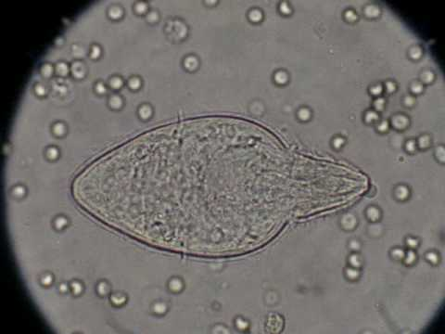
Miracidium

Slide 13
daughter-sporocysts give rise to the fork-tailed cercariae which are infective to man.
The cercariae break off from the sporocyst and escape from the snail into water.

Slide 14
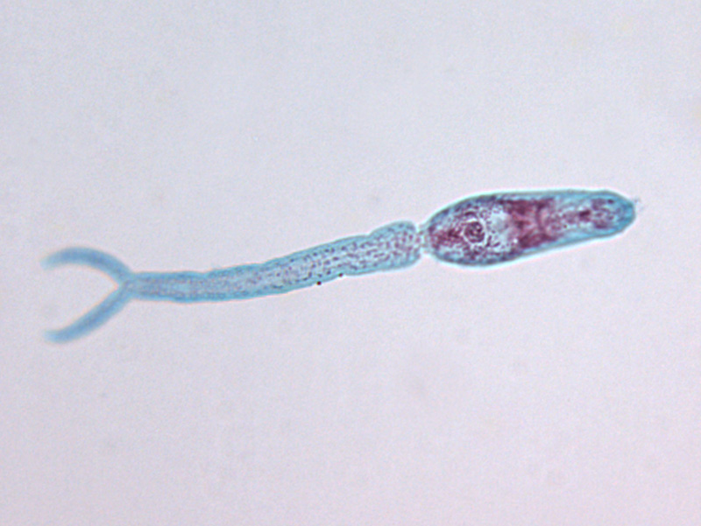
Cercaria

Slide 15
ENTRY INTO HUMAN
Infection results when human beings bathing in this water are infected, the cercariae penetrating the unbroken skin directly.
On entry the cercariae cast off their tailsand gain access to a peripheral venule.
From here, they are carried through the right heart into the pulmonary capillaries. To the lungs, whence they are carried through the left heart into the systemic circulation.
The majority are shunted in the abdominal aorta and gain access to the mesenteric artery, pass

Slide 16
Migration
through the capillary bed in the intestine and enter portal circulation (taking 5 days to reach the liver).
In the intrahepatic portion of the portal blood stream, the larvae grow into adults (maturing in 3 weeks from the time of entry).
After becoming sexually differentiated, they move out of the liver against the blood current, migrating into the inferior mesenteric vein, rectal venous plexus, pelvic veins, and eventually enter the vesical plexus of veins .
It takes about 1 to 3 months for the worms to reach the vesical and pelvic plexuses of veins after the initial exposure of the skin.

Slide 17
When the worms are sexually mature, they copulate (the females are enclosed in the males) and the fertilised females lay eggs which are ultimately voided with the urine.
The cycle is thus repeated

Slide 18
Pathogenicity.
An individual bathing in an infected pool or coming in contact with contaminated water is liable to be infected.
The cercariae stick to the surface of the skin of the swimmer or bather, by means of their ventral suckers (acetabula) and as the water begins to evaporate, penetrate the skin.
Infecting Agent-Cercariae.
Portal of Entry-Skin.
Site of Localisation-Vesical plexus of veins (urinary bladder).

Slide 19
PATHOGENESIS.
The terminal-spined eggs of S. haematobium may erode blood vessels and cause haemorrhages
Schistosome eggs, deposited in the tissues, act like foreign protein and have an irritative effect leading to round cell infiltration and connective tissue hyperplasia.
The tissue reaction in these cases produces what is known as formation of a “pseudotubercle ” around each egg (egg-granuloma).

Slide 20
The early nodules are highly cellular and are composed of eosinophils, giant cells, monocytes and lymphocytes;
later on, the cellular reaction tends to disappear and is replaced by a whorl of fibrous tissue, in the centre of which degenerated and calcified eggs may be found.
Large and progressive granulomas are found only around the eggs and may cause a diffuse fibrosis.

Slide 21
Schistosome granuloma.
The Schistosome eggs secrete soluble substances which pass through the pores of the egg-shell and provoke a granulomatous reaction, a manifestation of cell-mediated delayed hypersensitivity.
In sensitised individuals, granulomatous reaction becomes accelerated and enhanced on second exposure to eggs.

Slide 22
Clinical features ( schistosomiasis)
Known as BILHARZIASIS
1, By cercaria at the site of entrance: dermatitis
2, Toxic metaboloites released during growth in the liver: fever, urticarial, eosinophilia, hepatomegaly and splenomegaly
3, by eggs: producing painless terminal hematuria

Slide 23
Lab diagnosis
Microscopic examination of urine: presence of eggs terminal spined egg
Examination of vesical mucosal biopsy by cystoscopy

Slide 24
Schistosoma mansoni
Habitat : Lives in the sigmoidorectal region
Life cycle: eggs escape through feces
Pathogenecity: causing intestinal bilharziasis or schistosomal dysentery
Clinical features:
Intestinal- dysenteric attack
Ectopic- hepatomegly, periportal cirrhosis, portal hypertension

Slide 25
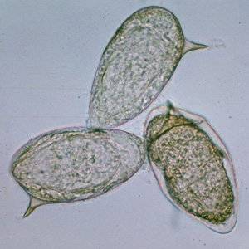
Eggs – lateral spine

Slide 26
Diagnosis
Stool examination for eggs
Rectal biopsy examination

Slide 27
Schistosoma japonicum
G.D: china, japan, philipines, Taiwan, burma
Habitat: portal venous system, ileo caecal region, rectal plexus of veins.
Life cycle: eggs escape through feces

Slide 28
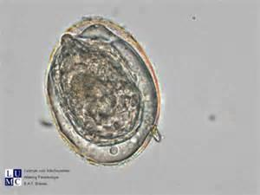
Eggs - lateral knob

Slide 29
Pathogenecity
Causing KATAYAMA DISEASE
Clinical features
Dystentry
Liver : periporatal cirrhosis
Schistosome hepatic fibrosis
Spleen: splenomegaly

Slide 30
Reference
Essentials of Medical Parasitology Apurba Sankar Sastry
Medical Parasitology K.D Chatterjee

